Slide 1
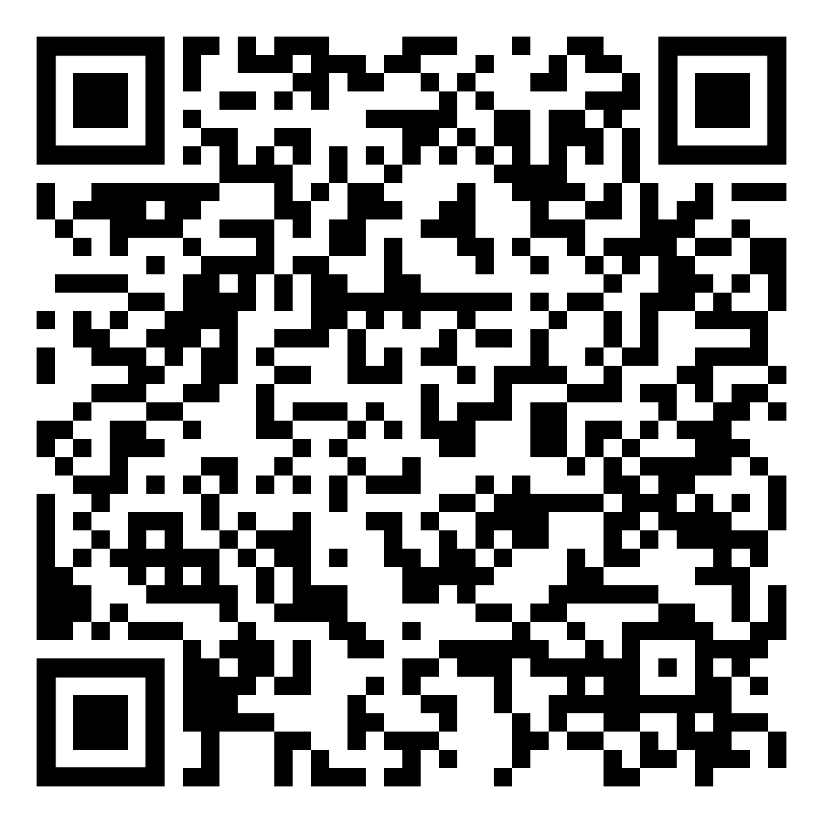
Leaves are falling, quitting smoking or vaping is calling
Now’s the time to create healthier, new habits
YOUR LOGO HERE
Get Started!
Are you feeling energized by the approach of fall? Don’t let the season be the only things that transforms. Instead, take the first step to kick the habit with the help of Pivot, the plan that works even for those not quite ready to quit.
Try something new,
see real progress
Claim your Pivot SmartSensor*, proven to help reduce the number of cigarettes smoked per person. Make this fall your chance to reduce or quit smoking and pair the SmartSensor* with the Pivot app, your dedicated coach, and nicotine replacement therapy (NRT)* for maximum success.
[Customized eligibility language].
Scan the code with your phone or visit pivot.co
Need help quitting vaping? We have a solution for that too!
*Pivot is a flexible program designed to address all forms of tobacco use. The Pivot SmartSensor and NRT are only provided to those who smoke combustible cigarettes.

Slide 2
Leaves are falling, quitting smoking or vaping is calling
Now’s the time to create healthier, new habits
YOUR LOGO HERE
Get Started!
Are you feeling energized by the approach of fall? Don’t let the season be the only things that transforms. Instead, take the first step to kick the habit with the help of Pivot, the plan that works even for those not quite ready to quit.
Try something new,
see real progress
Claim your Pivot SmartSensor*, proven to help reduce the number of cigarettes smoked per person. Make this fall your chance to reduce or quit smoking and pair the SmartSensor* with the Pivot app, your dedicated coach, and nicotine replacement therapy (NRT)* for maximum success.
[Customized eligibility language].
Scan the code with your phone or visit pivot.co
Need help quitting vaping? We have a solution for that too!
*Pivot is a flexible program designed to address all forms of tobacco use. The Pivot SmartSensor and NRT are only provided to those who smoke combustible cigarettes.

