Slide 1
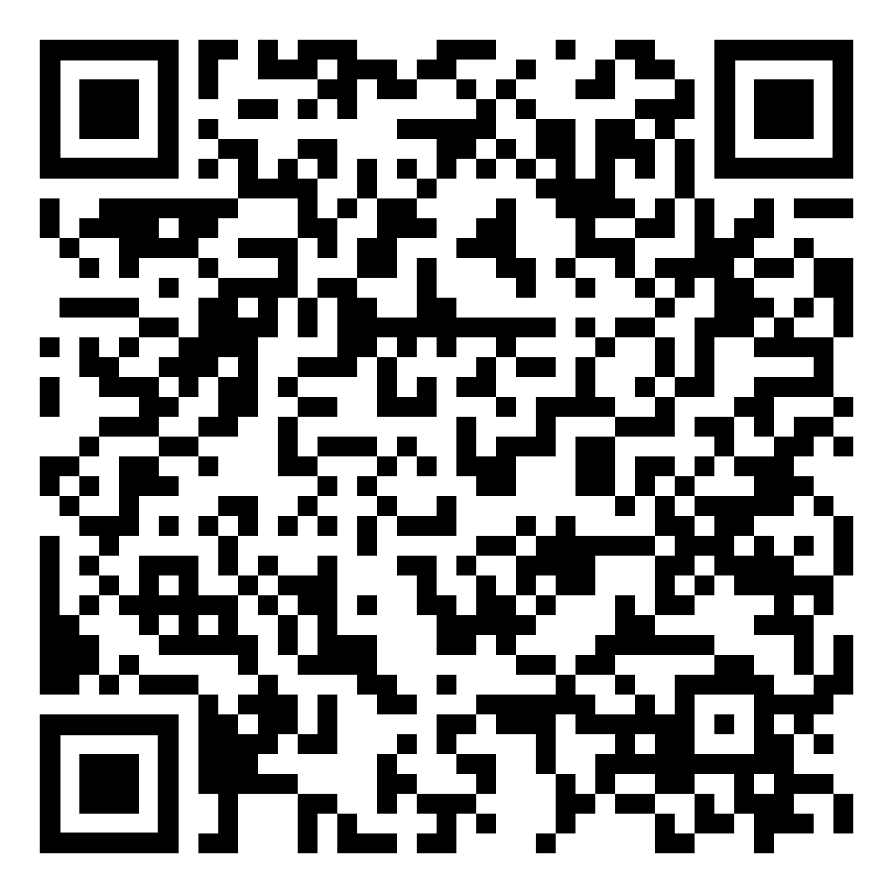
YOUR LOGO HERE
Leaves are falling, quitting smoking or vaping is calling.
Take advantage of your chance to quit.
[Customized eligibility language]. Take the first step to creating new, healthier habits. Get started today and gain access to the first FDA-cleared SmartSensor*, proven to help in quitting smoking.
Scan the QR code with your phone or visit pivot.co.
Need help quitting vaping?
We’ve got a solution for that too!
*Pivot is a flexible program designed to address all forms of tobacco use.
The Pivot SmartSensor is only provided to those who smoke combustible cigarettes.

