Slide 1
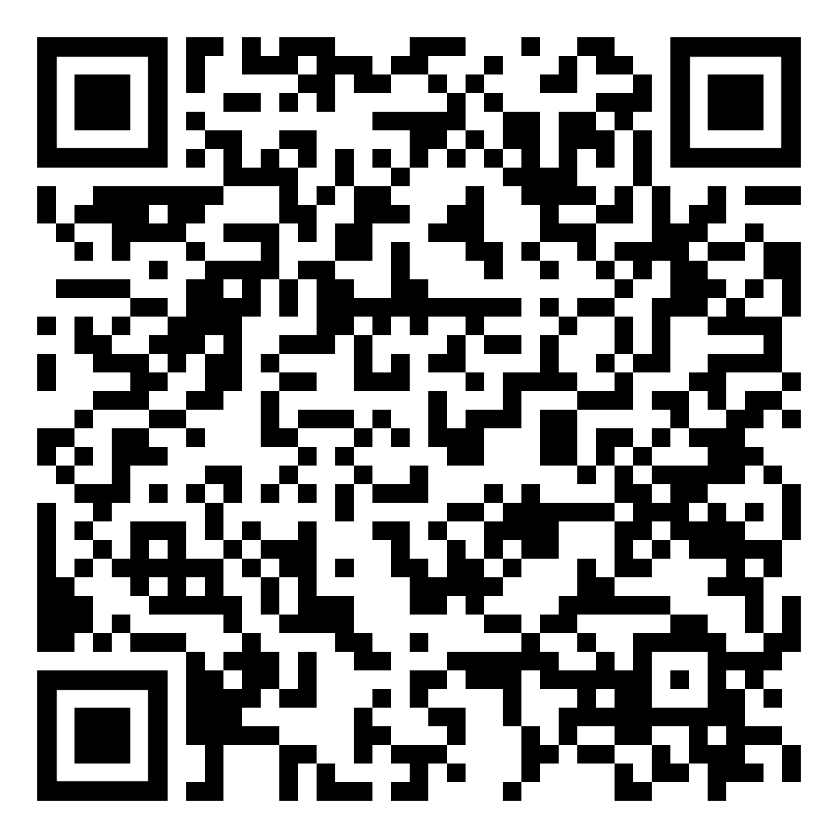
YOUR LOGO HERE
Leaves are falling, quitting smoking or vaping is calling.
Take advantage of your chance to quit today.
[Customized eligibility language].
Take the first step to creating new, healthier habits. Get started today and gain access to the first FDA-cleared SmartSensor*, proven to help in quitting smoking.
Need help quitting vaping?
We’ve got a solution for that too!
*Pivot is a flexible program designed to address all forms of tobacco use. The Pivot SmartSensor is only provided to those who smoke combustible cigarettes.
To learn more and sign up online, scan the code with your phone or visit pivot.co
SCAN ME

