Slide 1
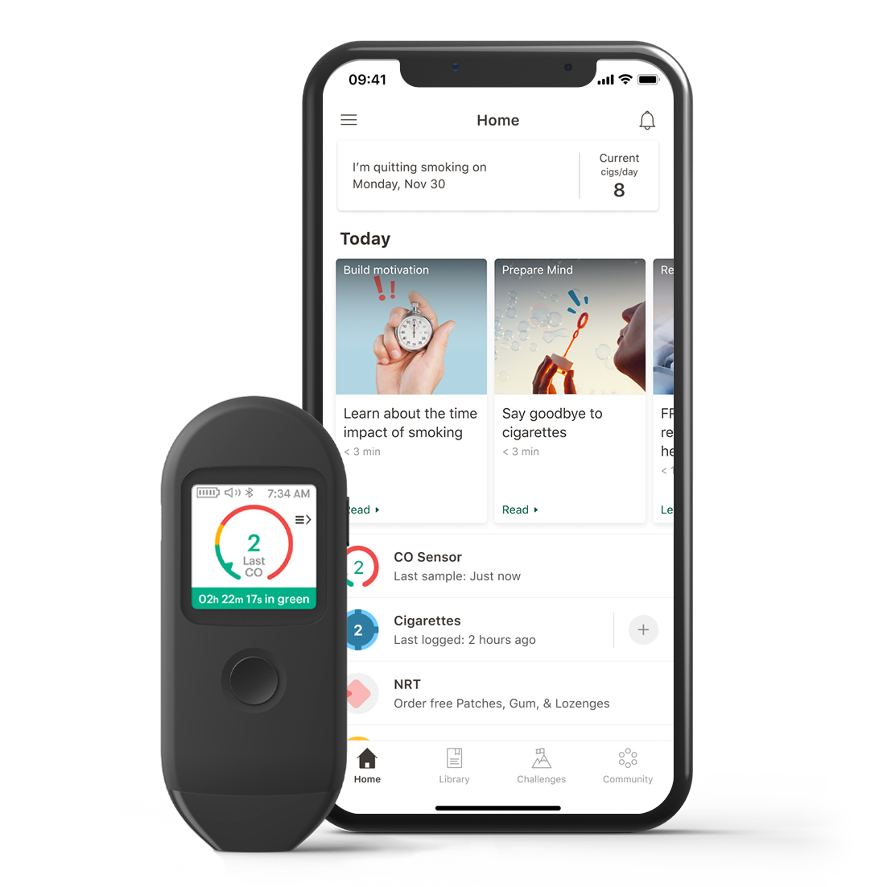
Tailor your quit journey, your way.
Pivot, a quit-tobacco program personalized for you. Pivot’s unique and personalized program begins with you, not a quit date. We start by helping people learn new behaviors and reduce their tobacco use — both of which ultimately lead to higher success rates. Pivot is a quit-smoking program based on your schedule, not ours.
[CUSTOMIZABLE SECTION FOR ELIGIBILITY MESSAGING].
Visit account.pivot.co
and use [CODE] for registration.
YOUR LOGO HERE
“Pivot made it possible to quit at my own pace. I was not intending to even quit smoking in the beginning… and I ended up quitting smoking.”
Tony C. | 57

Slide 2
Why Pivot Works
Pivot provides a personalized approach to help you quit — on your own schedule and at your own pace. The program can be tailored for cigarettes, smokeless tobacco, e-cigarettes or other vaping devices.
78%
Of Pivot users decreased their
number of cigarettes per day.
Pivot App: Learn and practice
Daily recommendations and challenges that are built for busy schedules. Based on years of research conducted by physicians, clinicians, and behavioral scientists.
Nicotine Replacement Products*: Reduce cravings
Proven to increase the chances of successfully quitting, are provided at no cost to participants. Order in the app and have them delivered directly to your door.
81%
Of users said Pivot was the best
quit program they had ever tried.
The Pivot SmartSensor*: Proven to increase motivation
Measures the carbon monoxide in exhaled breath. Visualize progress and see how
even small changes can have major impacts.
“Learning about how much I smoke, how much I spent... was so eye opening. I thought the breath sensor was one of the coolest things ever.”
John | 47
Support and Guidance: Available when needed
Tap into Pivot’s online community for collective wisdom or text in the app with a specially trained health coach, assigned to you, for personalized support and advice.
*indicated only for those who smoke cigarettes
MK-20487 REV. A

