Slide 1
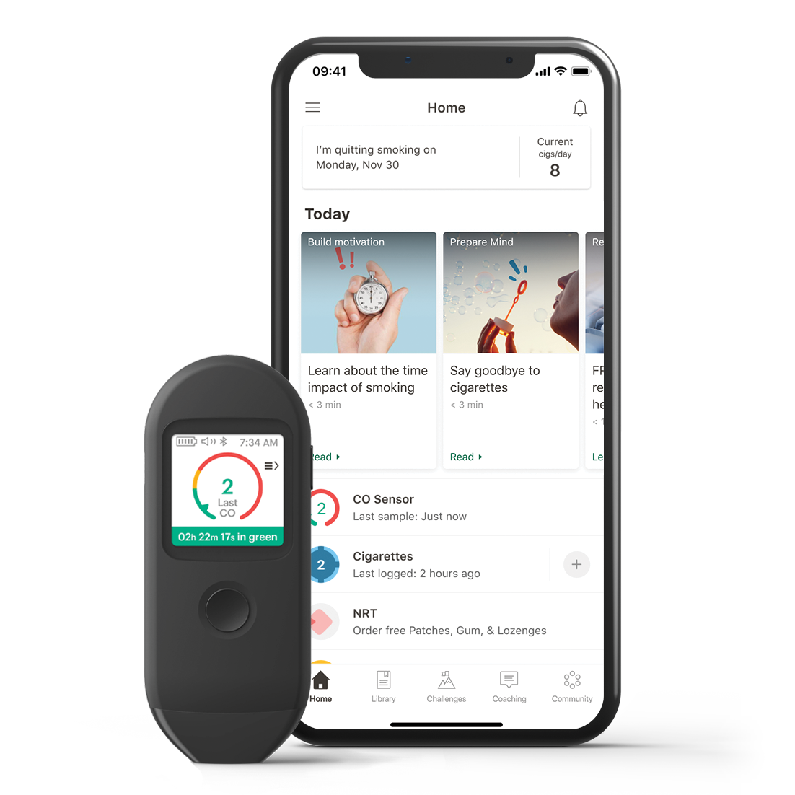
Start Now.
Quit Later.
You've tried quitting smoking. Now try Pivot.
Pivot is for people who smoke, vape or chew and want to get motivated to quit. For those who smoke cigarettes, Pivot includes an ultra-smart breath sensor that detects the levels of carbon monoxide in your breath, tracks your progress and provides motivation to reduce and ultimately quit smoking.
[Customizable copy for employee eligibility language].
Go to account.pivot.co to enter the code [CODE].
YOUR LOGO HERE
Pivot is a flexible program designed to address all forms of tobacco use, including cigarettes, smokeless tobacco, e-cigarettes and other vaping devices, with different feature sets available for each form of tobacco.
MK-20574 Rev A

