Slide 1
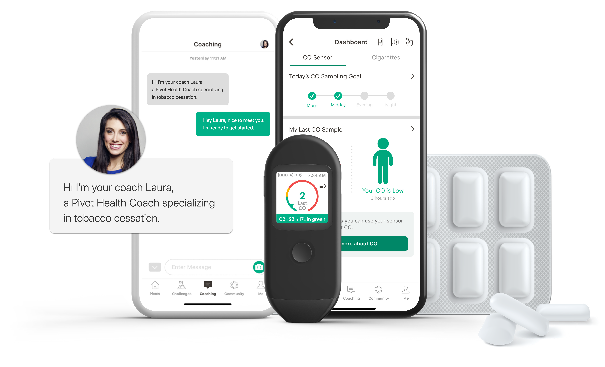
YOUR LOGO HERE
Pivot, a different approach to smoking — and quitting.
Pivot offers personal coaching, a mobile breath sensor, and engaging lessons delivered via a simple smartphone app. You get to engage in your own way, whenever and wherever you want.
[Customizable copy for employee eligibility language].
Go to account.pivot.co to enter the code [CODE].
Pivot is a flexible program designed to address all forms of tobacco use, including cigarettes, smokeless tobacco, e-cigarettes and other vaping devices, with different feature sets available for each form of tobacco.
MK-20574 Rev A

