Slide 1
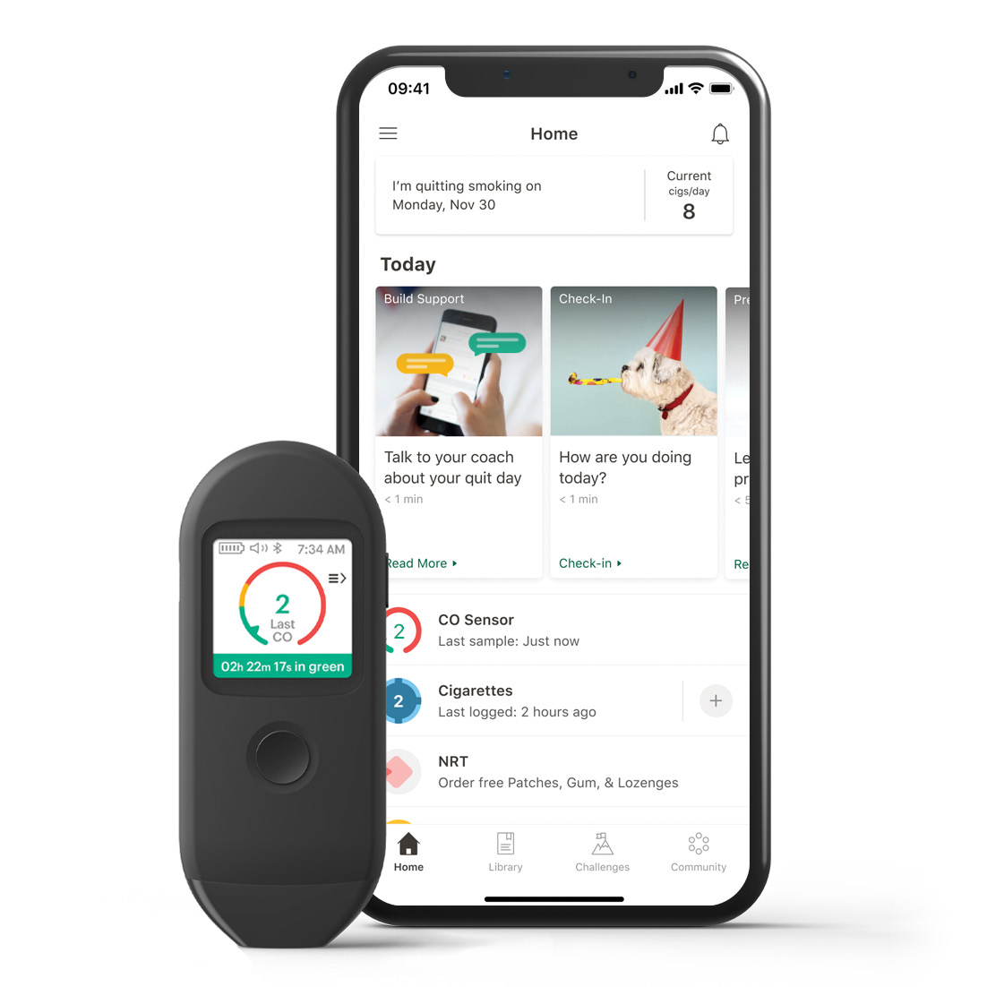
Pivot, a quit-tobacco program, tailored for you.
YOUR LOGO HERE
First-of-its-kind SmartSensor to track your progress!
Pivot's best-in-class program best-in-class program uses proven strategies to help you reduce how much you smoke and customize a plan to reach your goals.
[CUSTOMIZABLE SECTION FOR ELIGIBILITY MESSAGING].
Learn more and sign up online, visit account.pivot.co.
Use access code: [CODE].

