Slide 1


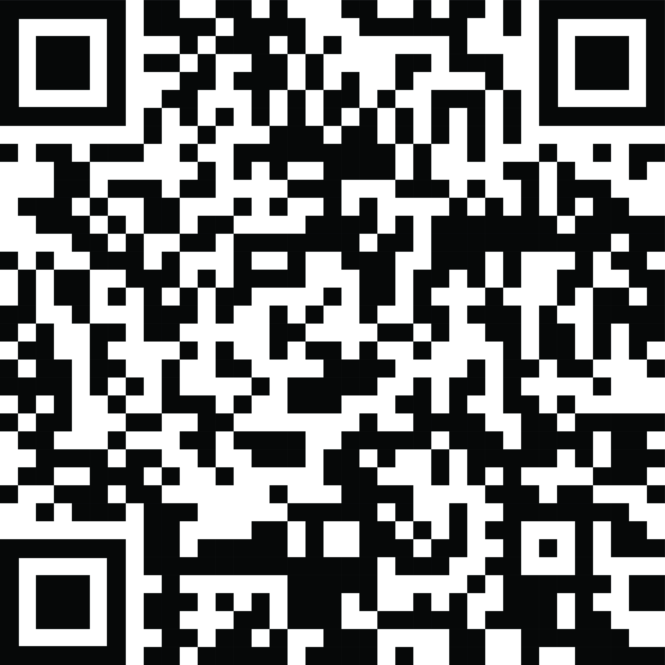
YOUR LOGO HERE
Take the first step toward quitting smoking.
Quitting smoking can be hard. Pivot makes it easier. The only program that provides every participant who smokes with your own personal Pivot SmartSensor* — a new tool to inspire and support you.
Free for [company_name] employees.
Make Today Day 1!
Scan the code with your phone and use access code [CODE]. Or visit pivot.co/partner.
*Don’t smoke cigarettes? Pivot can also be tailored for vaping, cigars, or any smokeless tobacco product.

