Slide 1
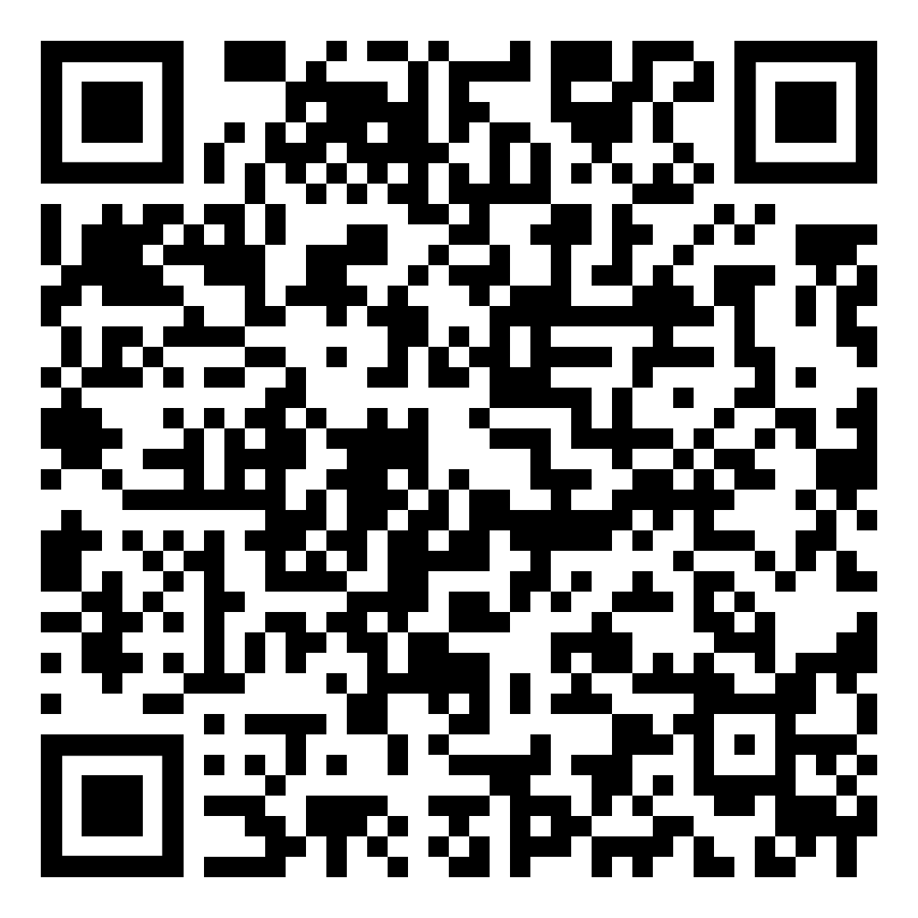
Quitting smoking just got easier.
Introducing the Pivot SmartSensor
Some say it’s magic — we say it’s science.
Pivot is the only quit smoking program with an FDA-cleared device clinically proven to help you quit smoking.
Want help with quitting vaping, cigars, or smokeless tobacco? We’ve got a solution for those too!
Scan the box with your phone’s camera or visit:
pivot.co/URL LINK

Slide 2
Pivot now, quit when you’re ready.
Smoking • Vaping • All Tobacco
YOUR LOGO HERE
Pivot Includes:
Pivot App
SmartSensor*
Free supply of Nicotine Replacement Therapy (NRT)*
Unlimited access to personal coaching
Online community
www.pivot.co/URL LINK
Access Code: [CODE]
Questions? Give us a call at
855-374-7727!
*NRT and the Pivot SmartSensor are only available to those who smoke cigarettes.

