Slide 1
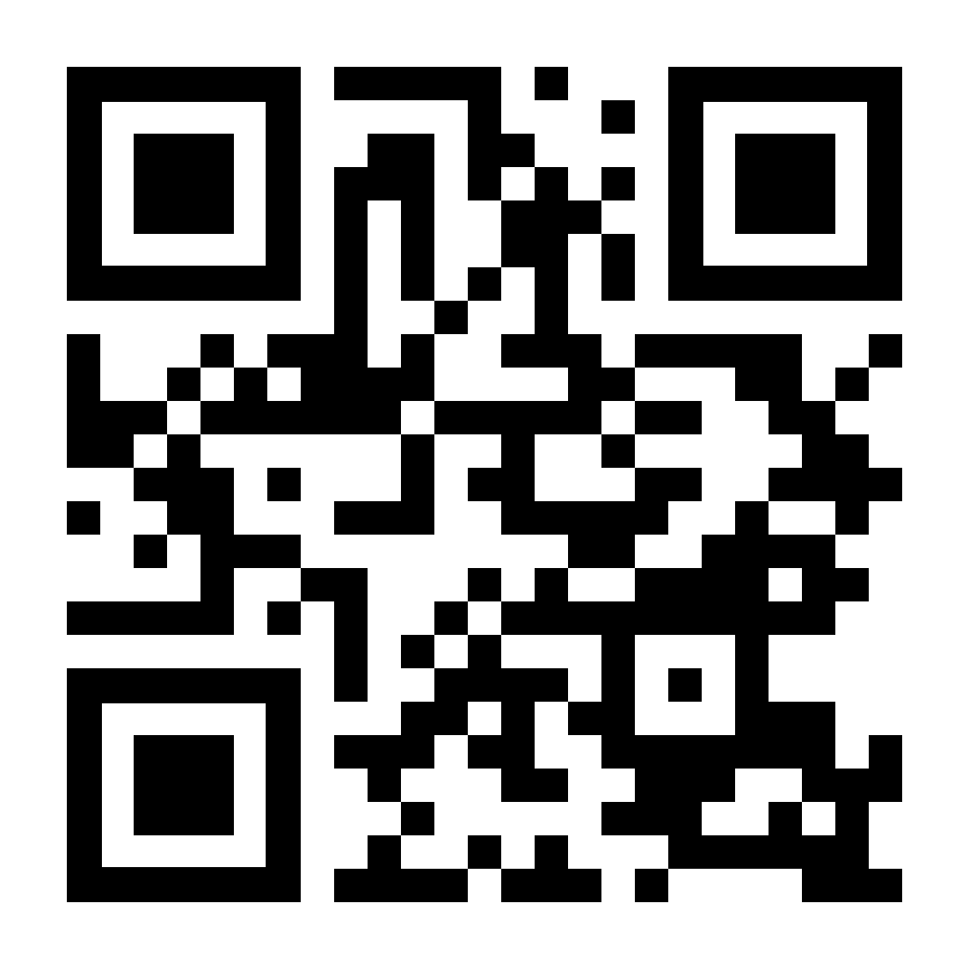
YOUR LOGO HERE
YOUR LOGO HERE
[Custom Eligibility Language]
[Custom Eligibility Language]. Scan the QR code with your phone or visit pivot.co

Slide 2
[Custom Eligibility Language]. Scan the QR code with your phone or visit pivot.co

