Slide 1
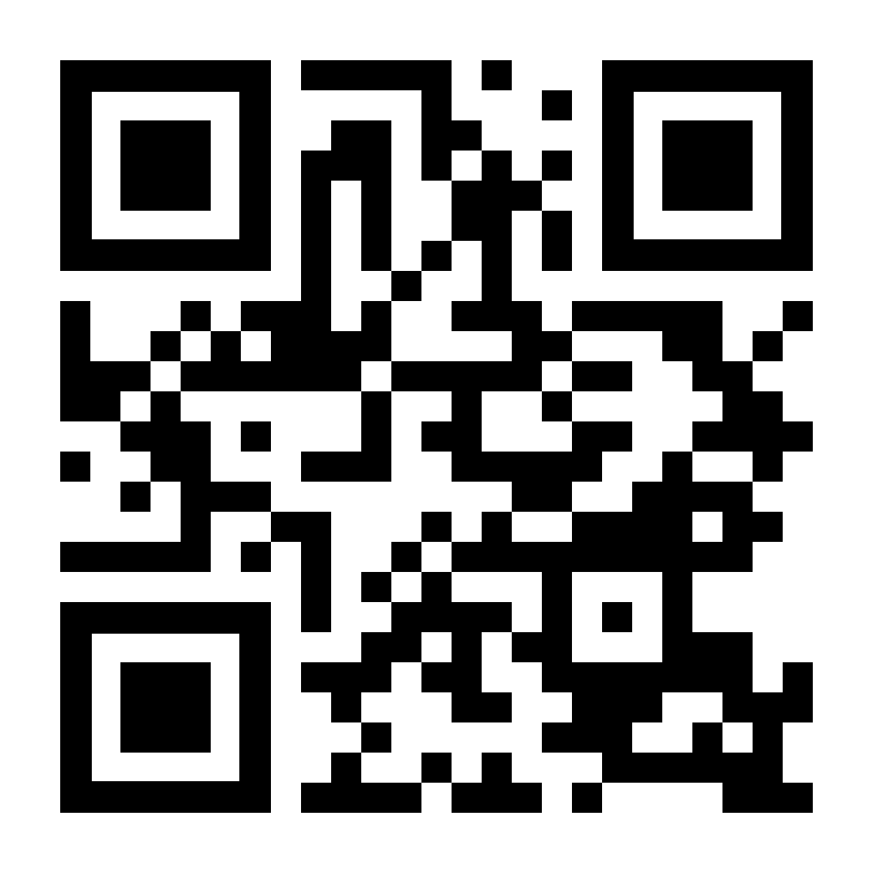
YOUR LOGO HERE
[Customized eligibility language].
To sign up online, scan the QR code with your phone’s camera or visit pivot.co to learn more.

