Slide 1
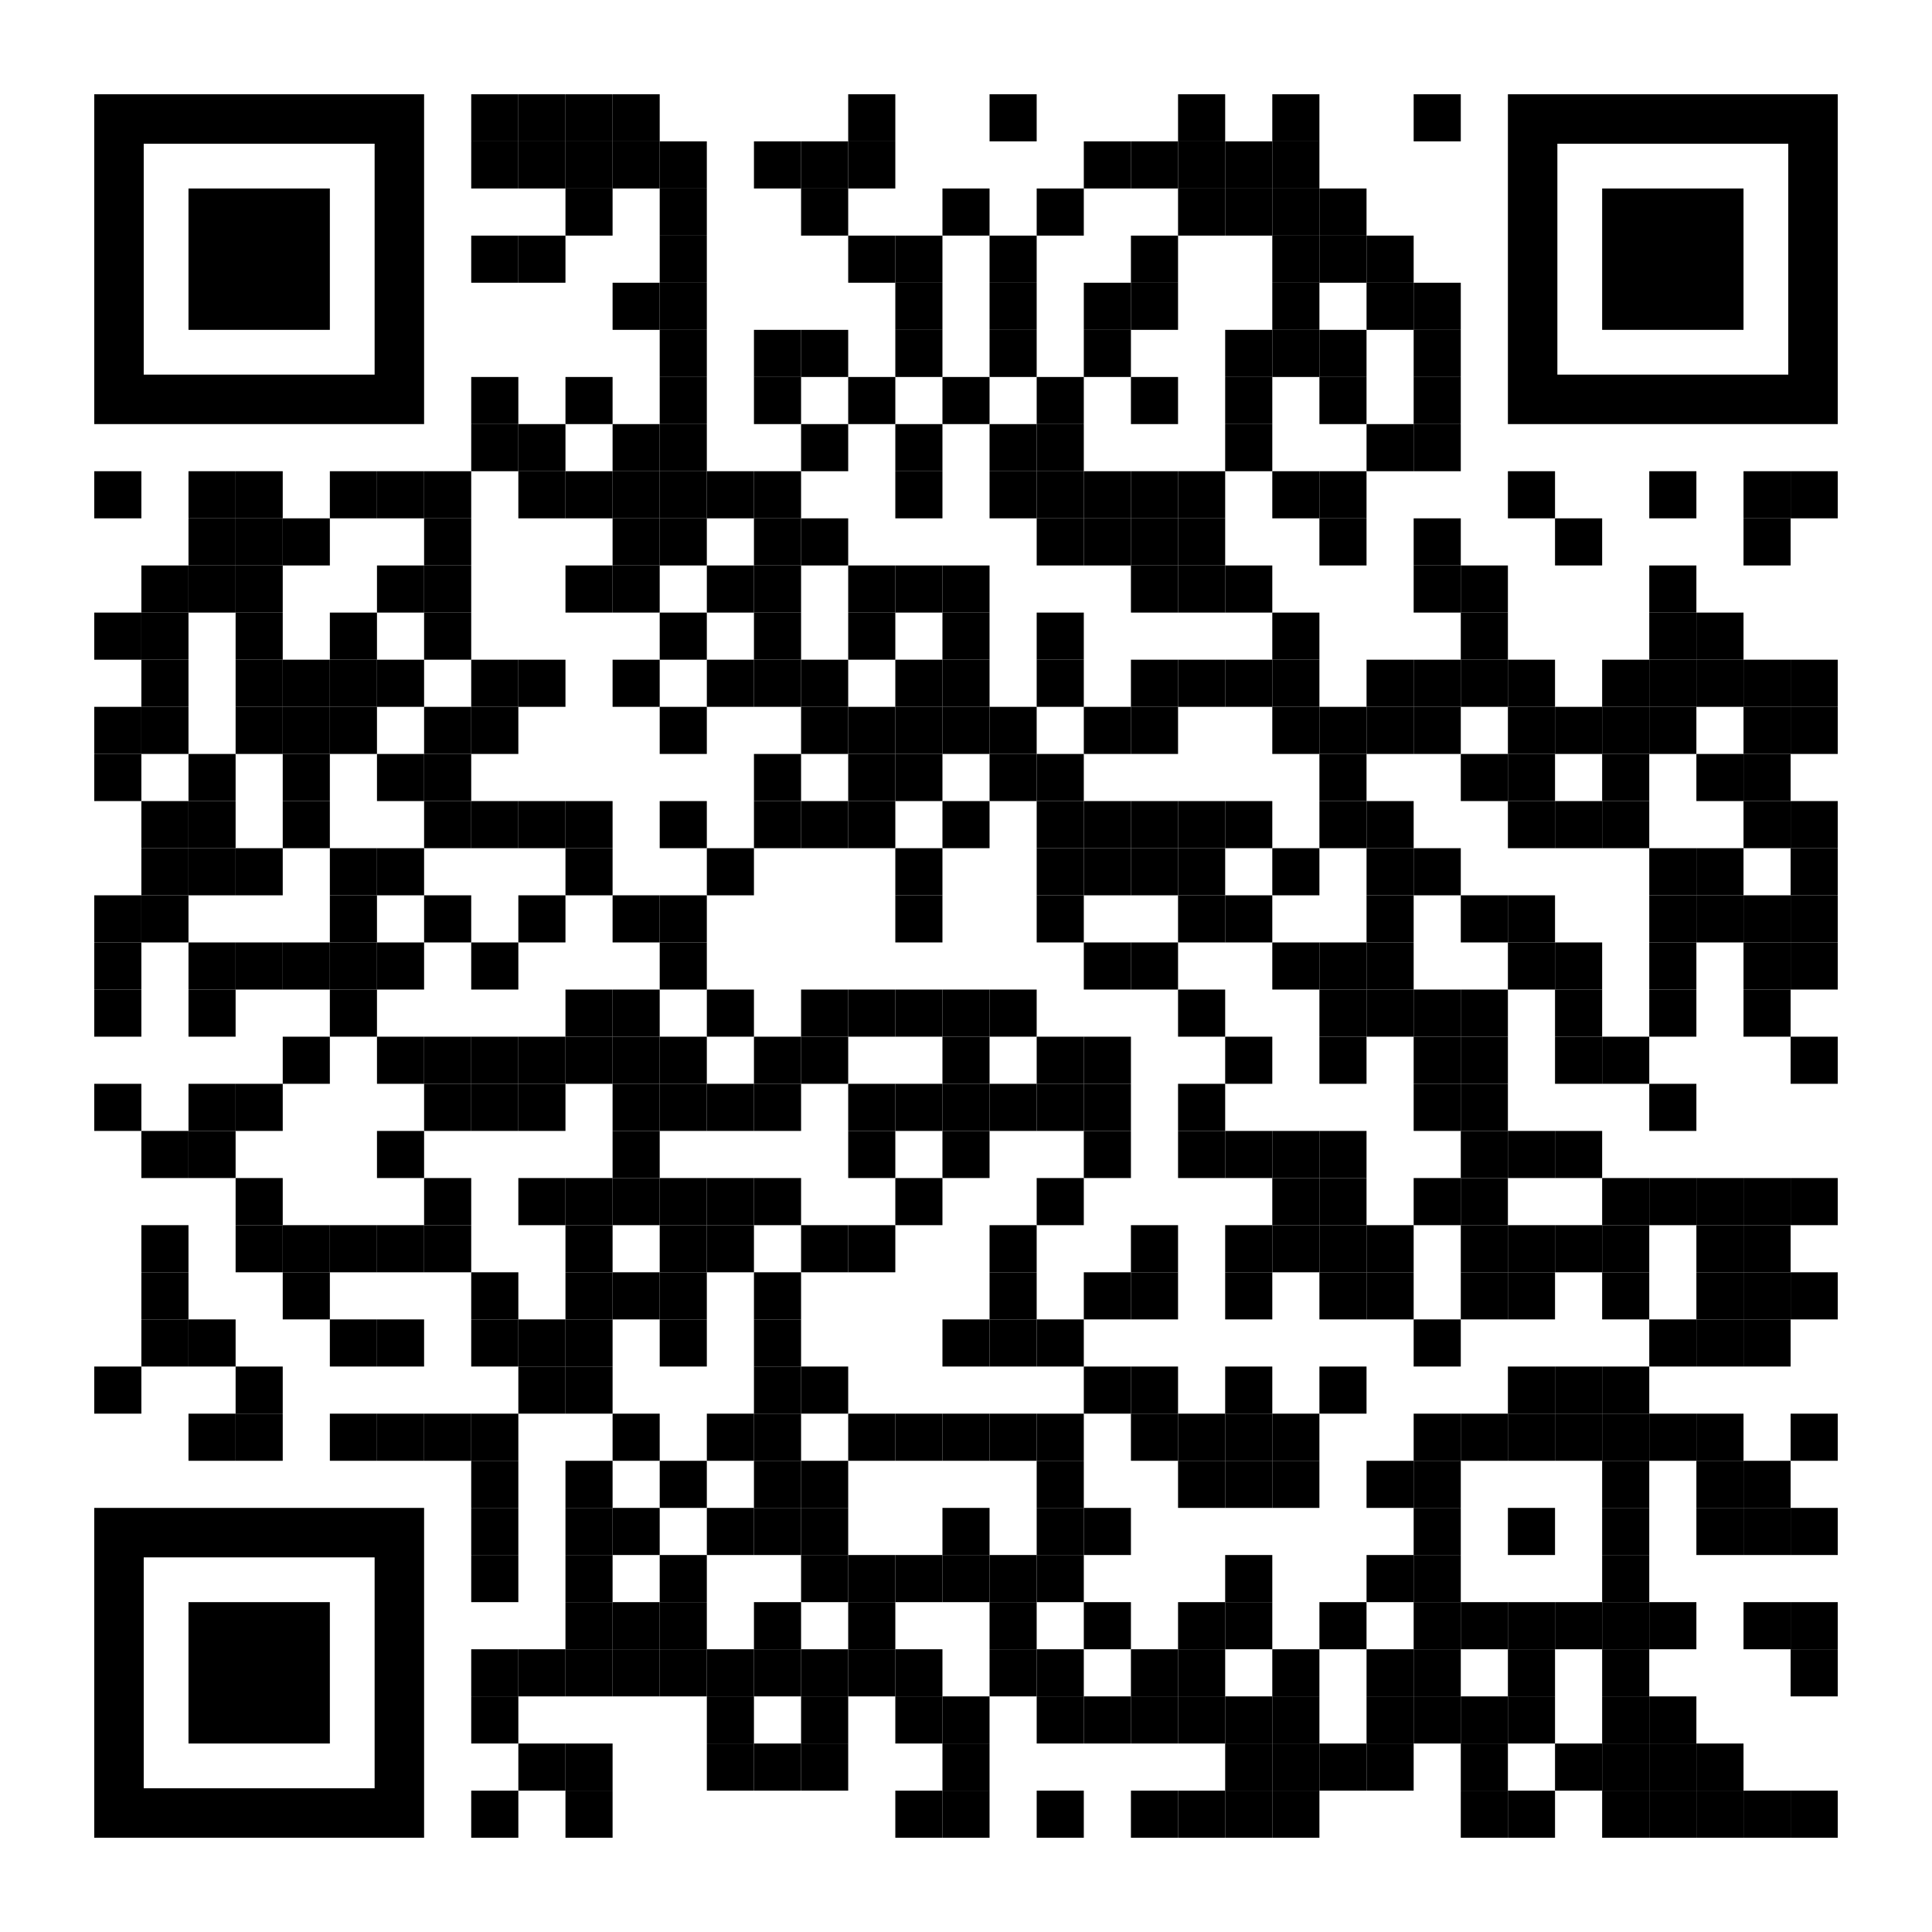
YOUR LOGO HERE
Let healthier habits in this spring.
Start fresh with Pivot.
[Customized eligibility language]
Get the new beginning you deserve with the quit smoking approach proven to work. Whether you’re ready to quit, wish it was the right time, or are exploring your options, Pivot can help you on your journey, no matter where you’re at. Focusing on gradual reduction — accompanied by the tools participants need to succeed — Pivot makes the journey to quit easier.
Convenience in your pocket.
Pivot combines a personalized support app filled with content tailored specifically to your goals, direct access to a quit tobacco coach, and the FDA-cleared hand-held SmartSensor* device, proven to help in quitting smoking. That means no classes, phone calls, or obligations — use Pivot when you need it, wherever you need it.
Get started today!
Scan the QR code above and use access code [CODE]. Or visit pivot.co/partner.
*Pivot is a flexible program designed to address all forms of tobacco use, including cigarettes, smokeless tobacco, e-cigarettes and other vaping devices. The Pivot SmartSensor is available only for those who smoke cigarettes.

