Slide 1


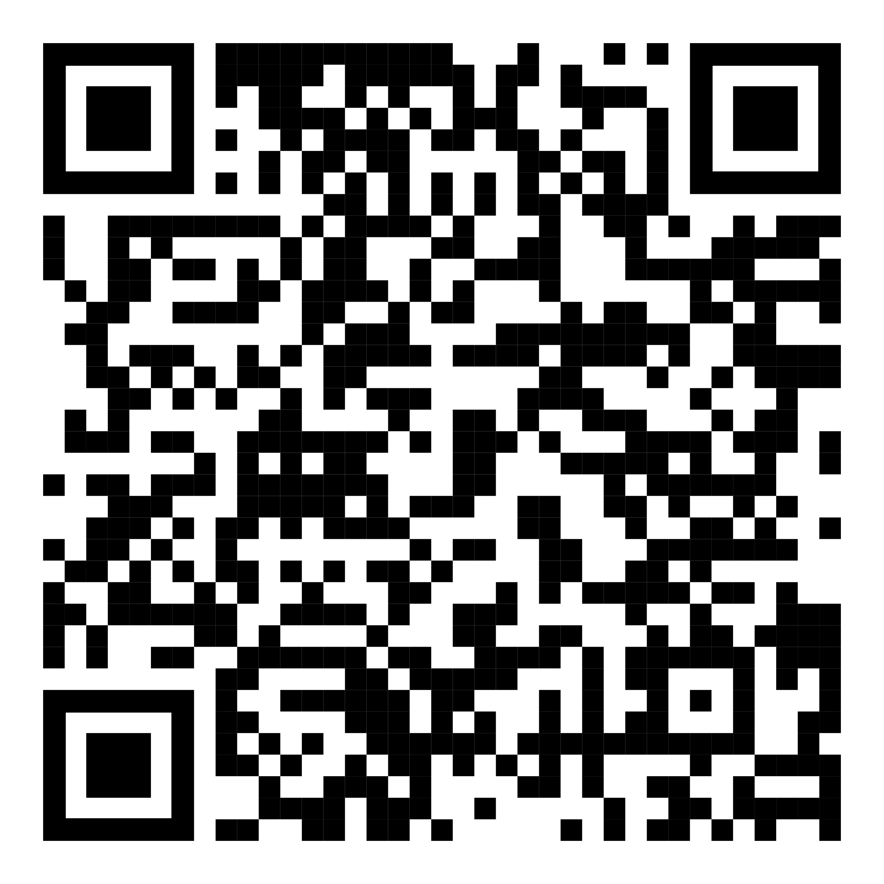
YOUR LOGO HERE
Start fresh with Pivot
[Customized eligibility language].
Take advantage of spring and claim your new beginning! Make the first step toward quitting smoking by signing up for Pivot*, free for [company name employees].
Scan the QR code with your phone and use access code [CODE].Or visit pivot.co/partner.
Need help quitting vaping?
We’ve got a solution for that too!
*Pivot addresses all forms of tobacco use.

