Slide 1
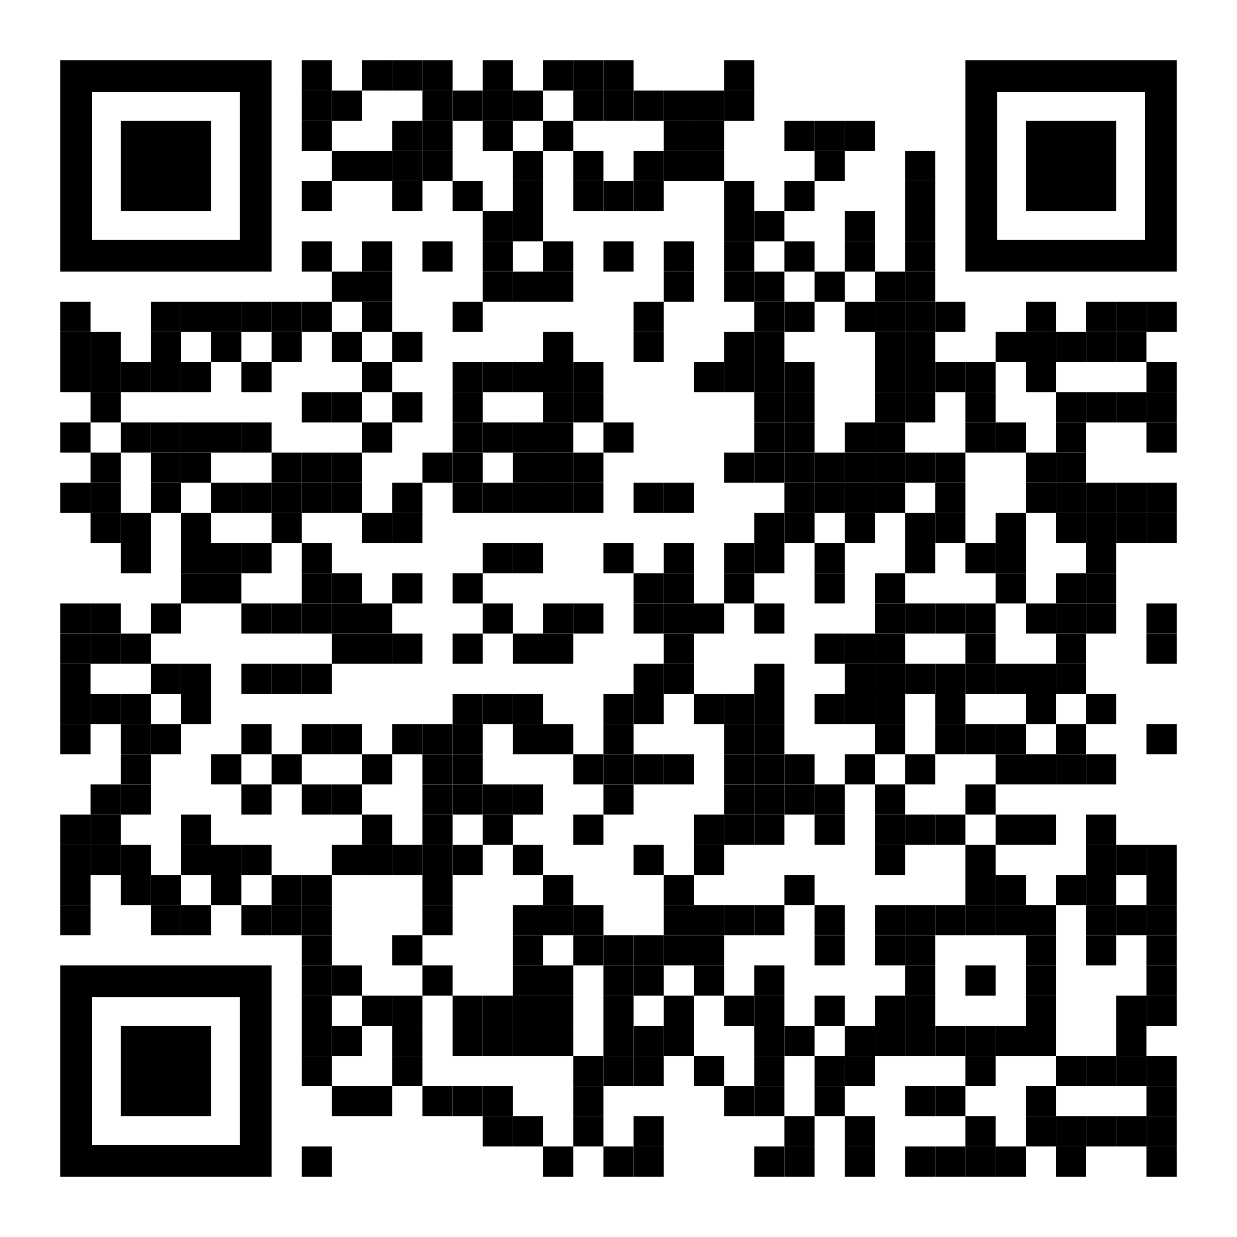
YOUR LOGO HERE
Let healthier habits in this spring
Start fresh with Pivot
[Customized eligibility language]
Get the new beginning you deserve with Pivot, the quit smoking approach proven to work. Pivot’s app-based, holistic program helps you gradually reduce your smoking and track your progress, allowing you to quit when you’re ready.
Available free of charge to [company name] employees. Scan the code with your phone and use access code [CODE]. Or visit pivot.co/partner.
*Pivot is a flexible program designed to address all forms of tobacco use, including cigarettes, smokeless tobacco, e-cigarettes and other vaping devices. The Pivot SmartSensor is available only for those who smoke cigarettes.

