Slide 1
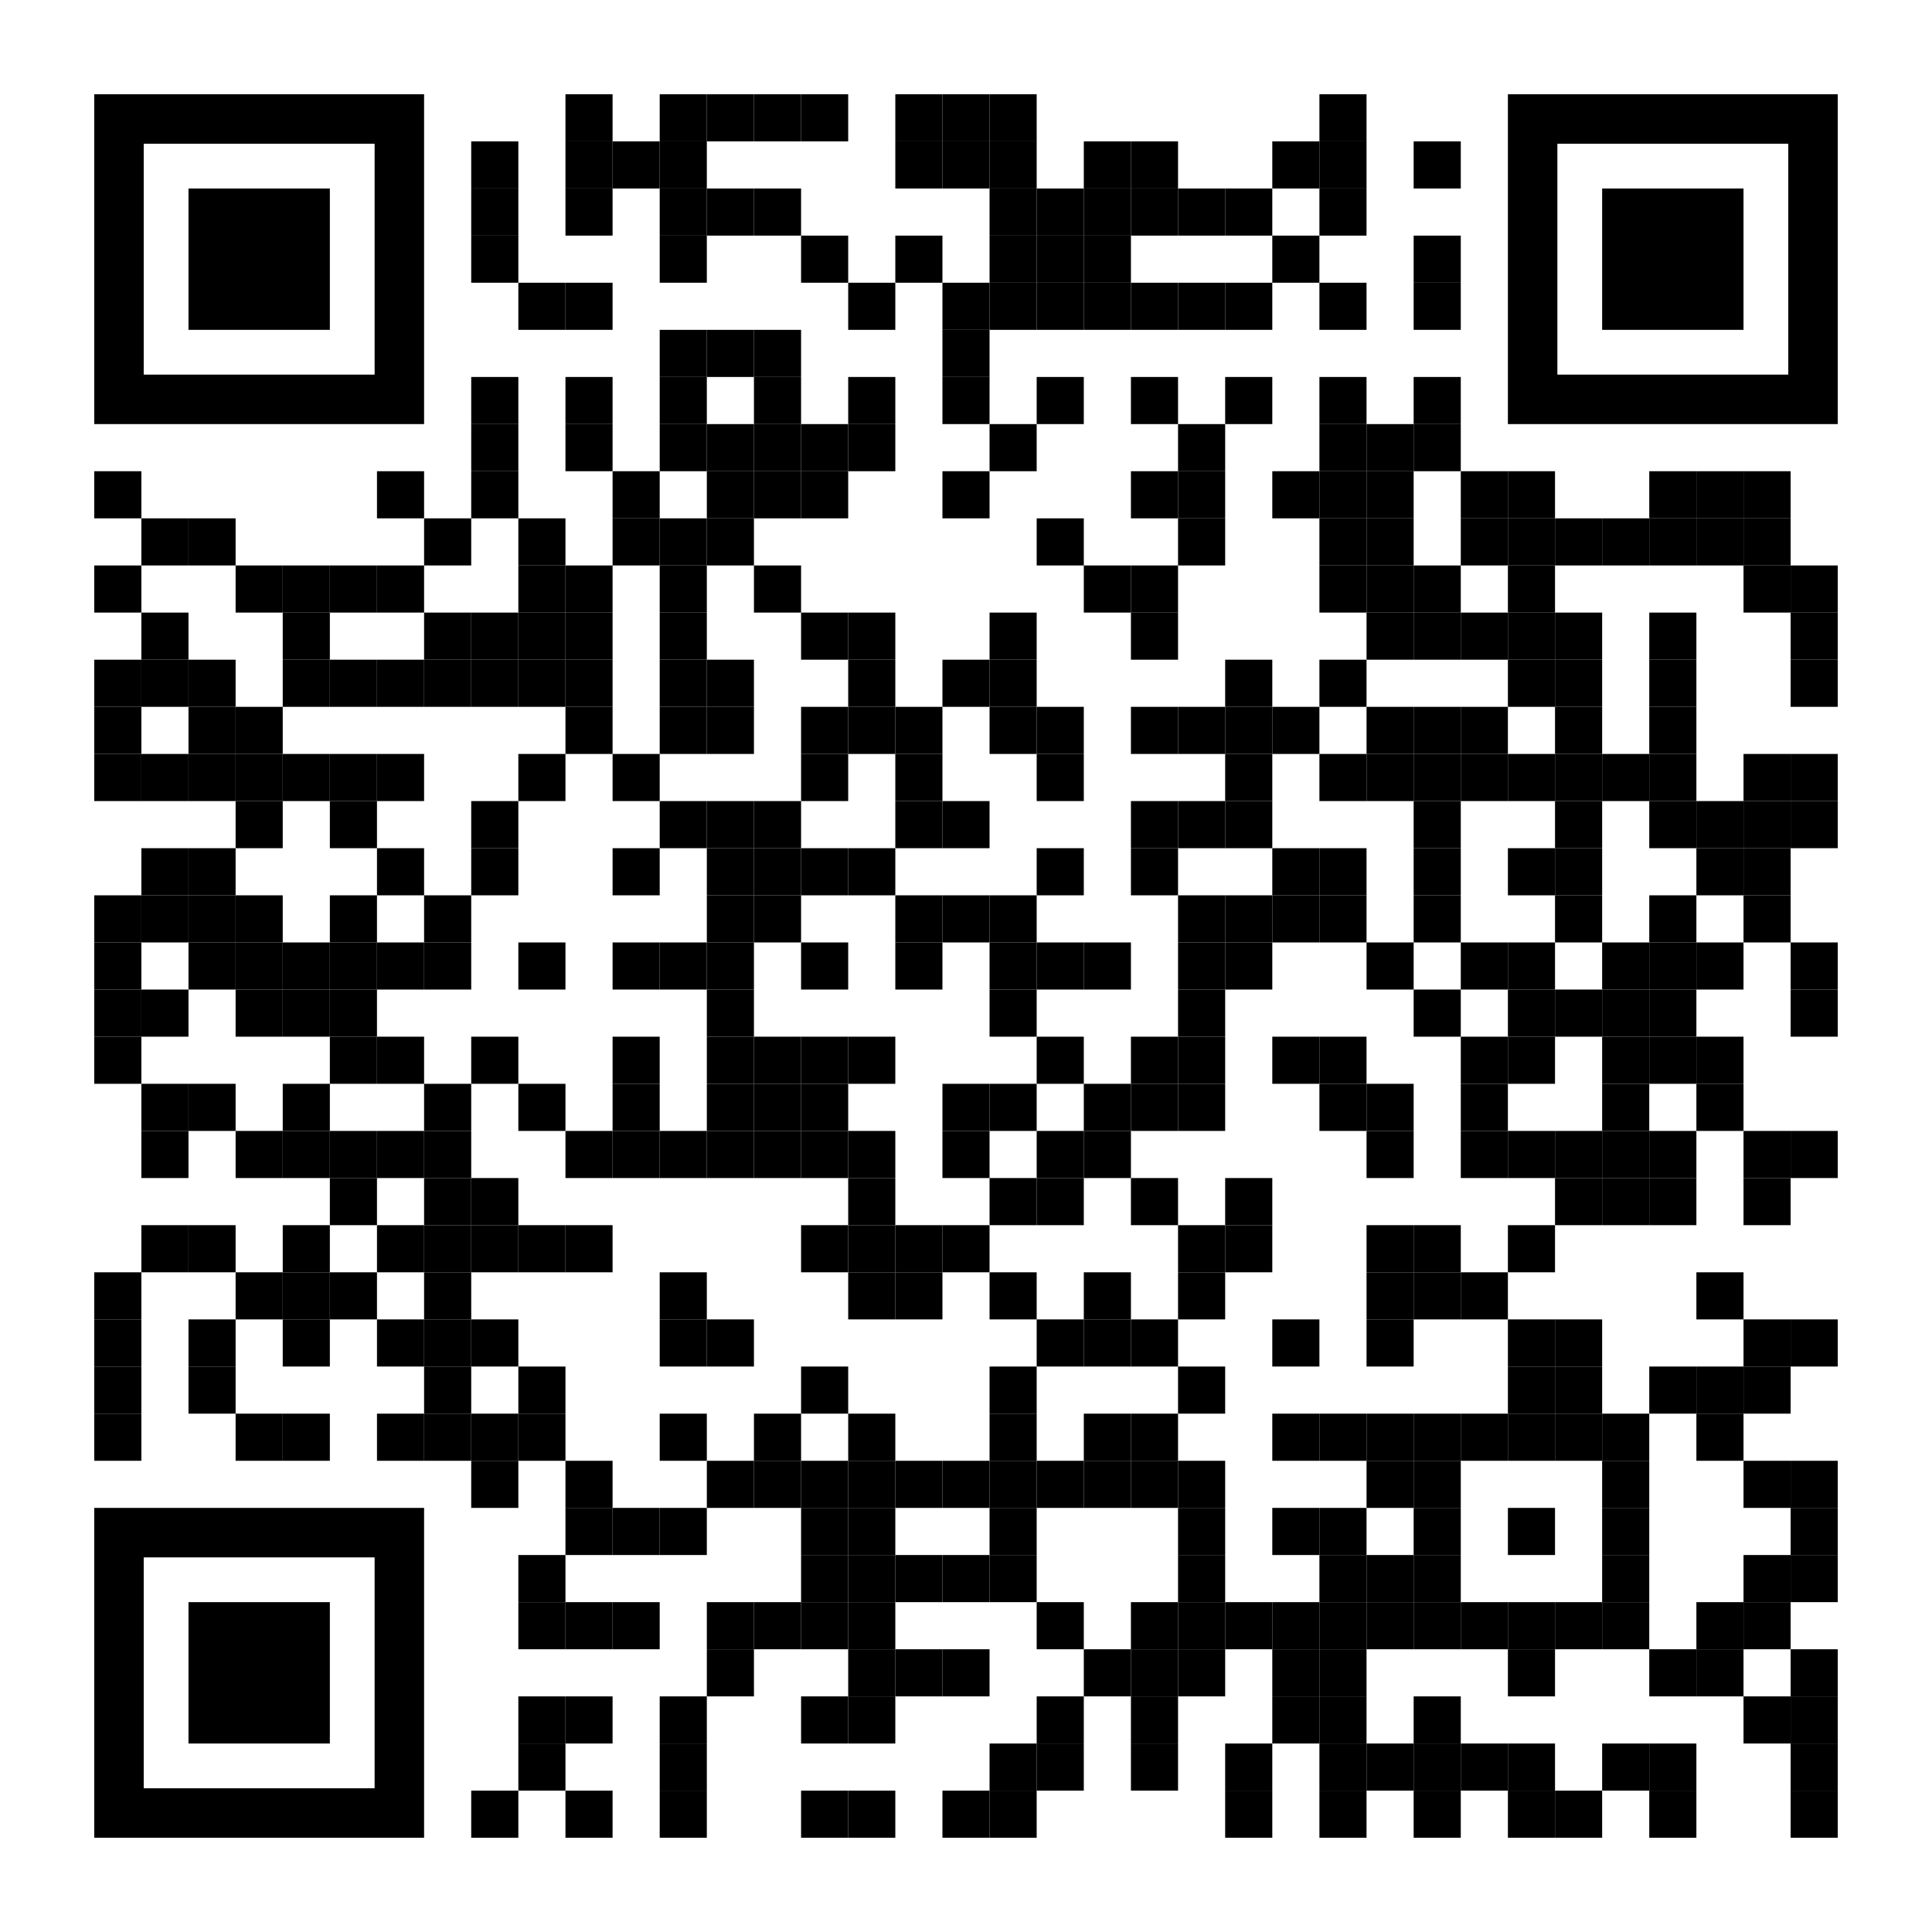
YOUR LOGO HERE
Start fresh with Pivot.
[Customized eligibility language].
Take advantage of spring and claim your new beginning! Make the first step toward quitting smoking by signing up for Pivot*, free for [company name employees].
To learn more and sign up online, scan the code with your phone or visit pivot.co/partner.
Use access code: [CODE].
Need help quitting vaping? We’ve got a solution for that too!
*Pivot addresses all forms of tobacco use.

