Slide 1
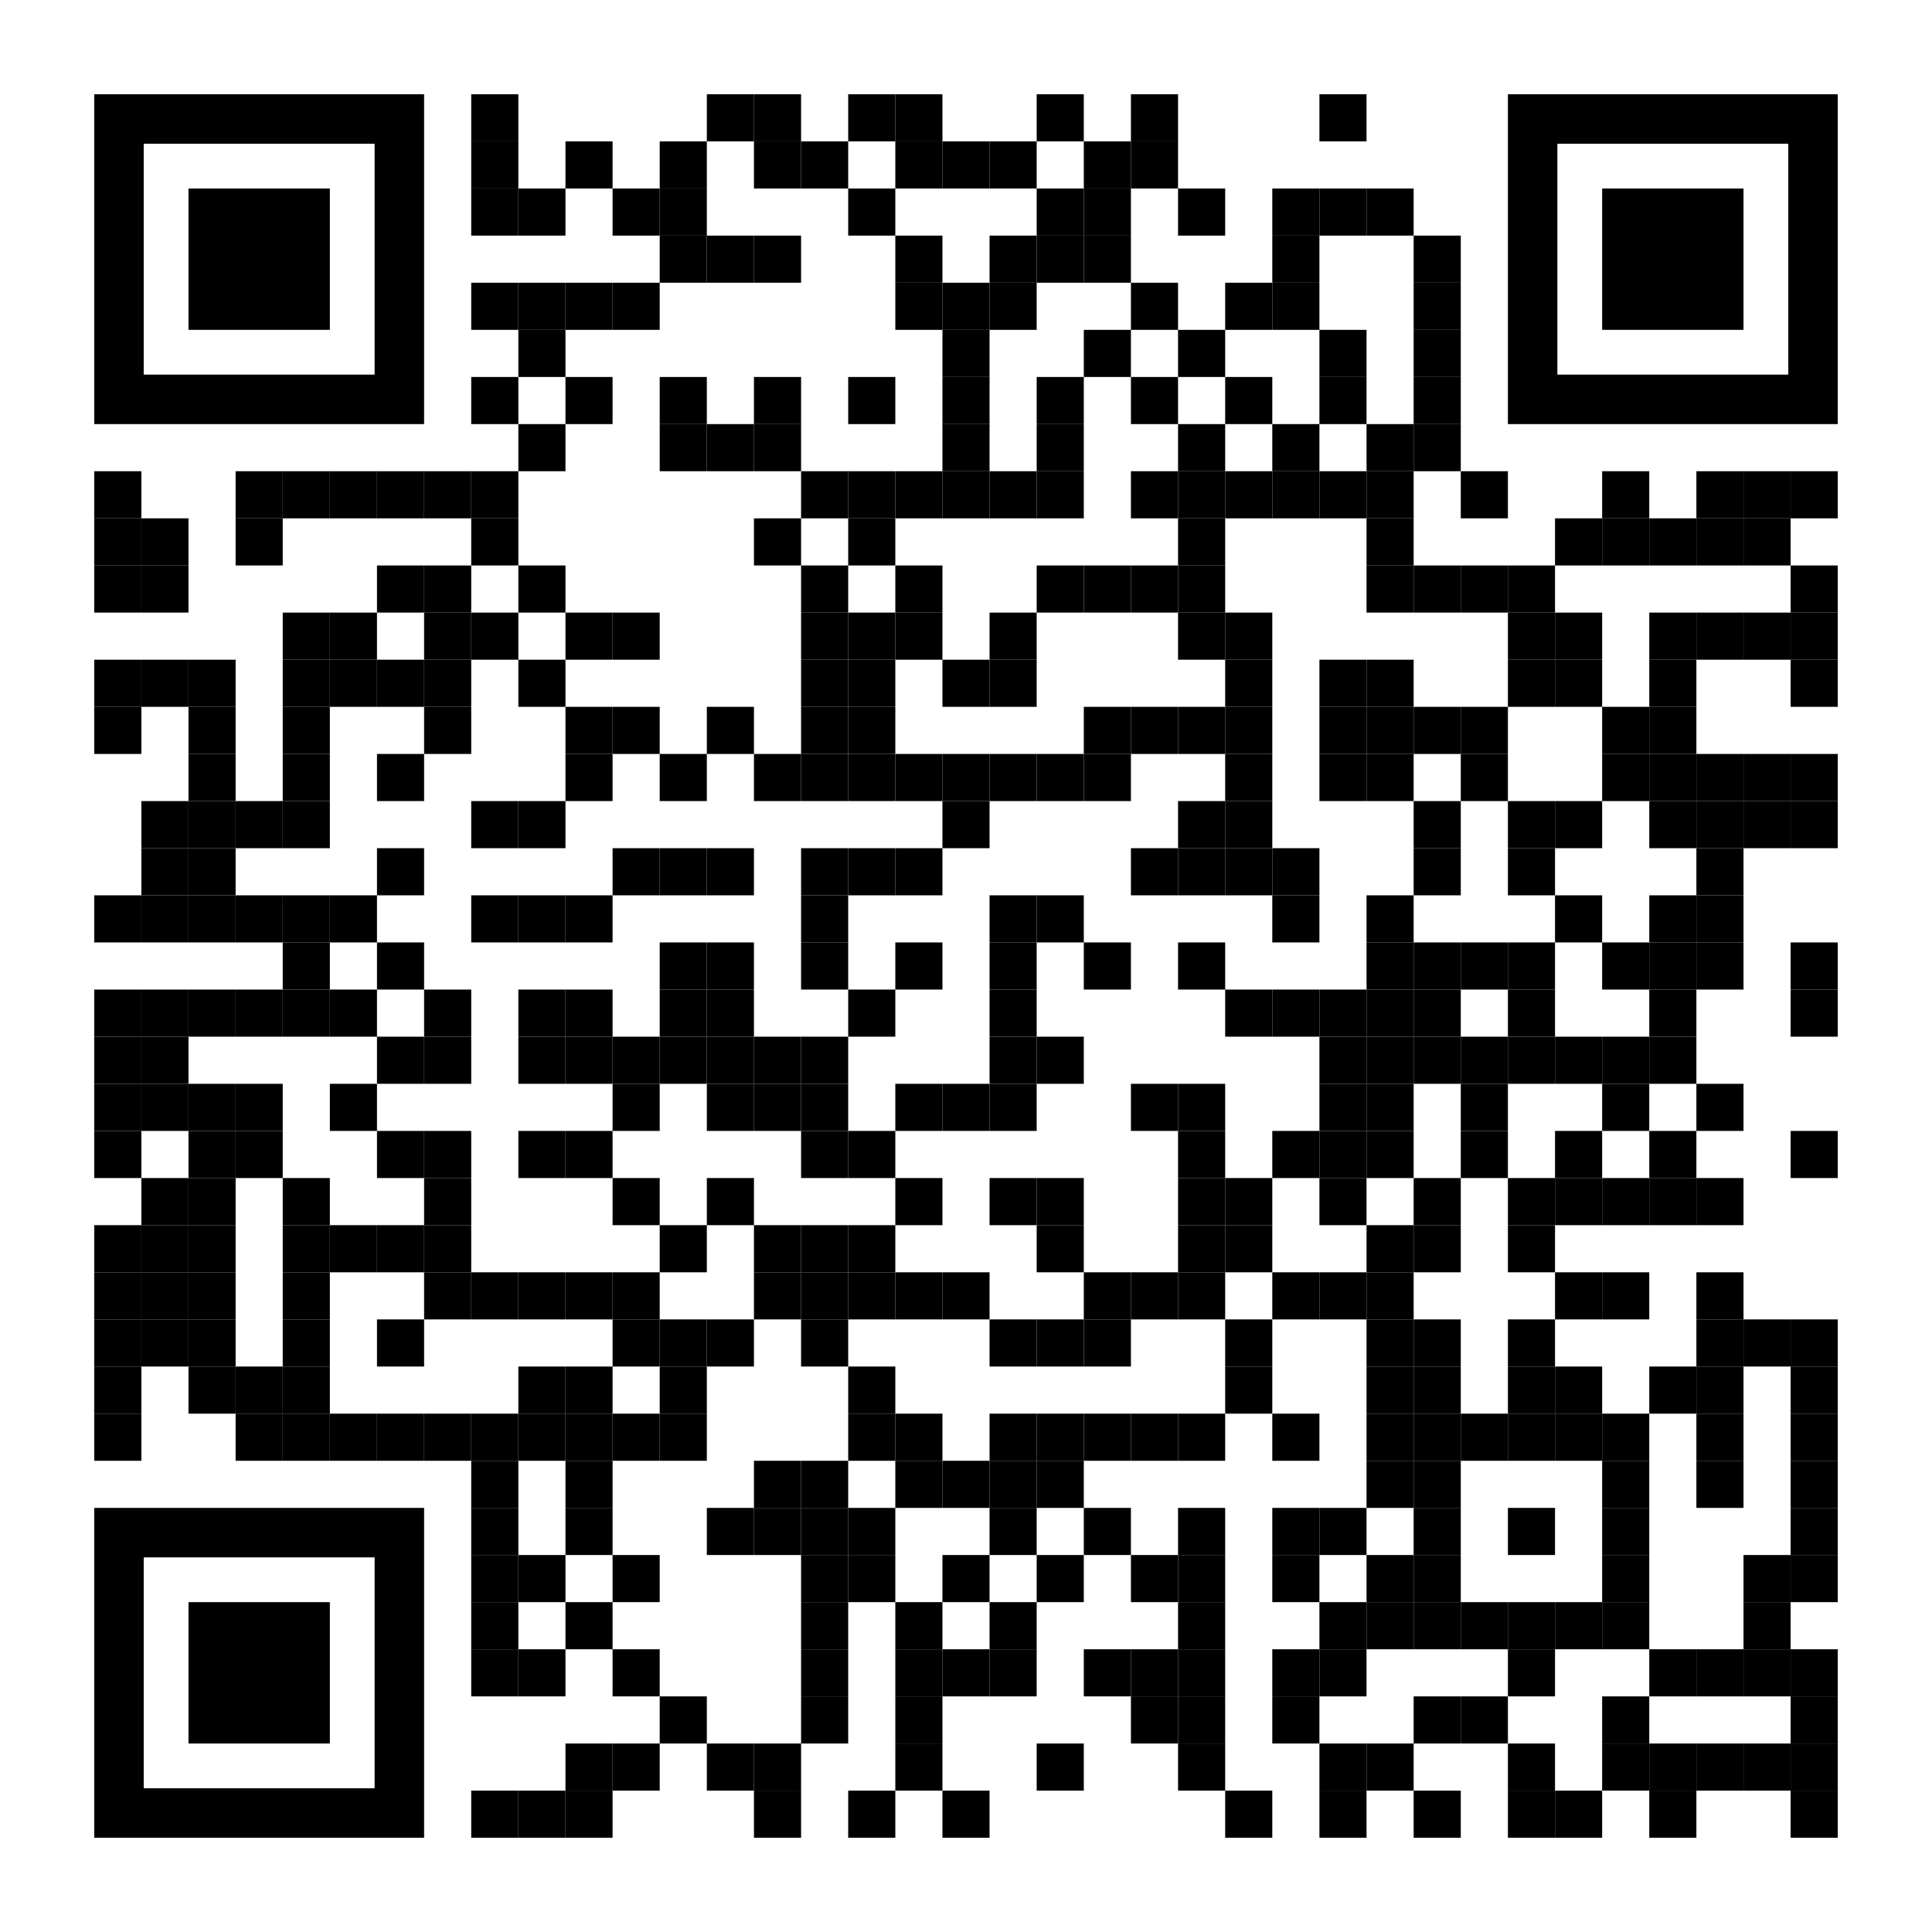
Stressed about quitting smoking?
Rid yourself of both with Pivot — at no cost to you.
Smoking may feel like stress relief in the moment, but it actually makes stress worse as time goes on, increasing blood pressure, tensing muscles, tightening blood vessels, and wreaking havoc on mental health. People turn to cigarettes hoping for relief, but are left feeling more stressed than ever. There’s good news, though — you don’t have to be stuck in the stress cycle with the help of Pivot.
Convenience in your pocket.
Pivot combines a personalized support app filled with content tailored specifically to your goals, direct access to a quit tobacco coach, and the FDA-cleared hand-held SmartSensor* device, proven to help in quitting smoking. That means no classes, phone calls, or obligations — use Pivot when you need it, wherever you need it.
YOUR LOGO HERE
Get Started!
[Customized eligibility language].
Scan the code with your phone or visit [pivot.co/partner] and use code [CODE]
Need help quitting vaping? We have a solution for that too!
*Pivot is a flexible program designed to address all forms of tobacco use. The Pivot SmartSensor and NRT are only provided to those who smoke combustible cigarettes.

