Slide 1


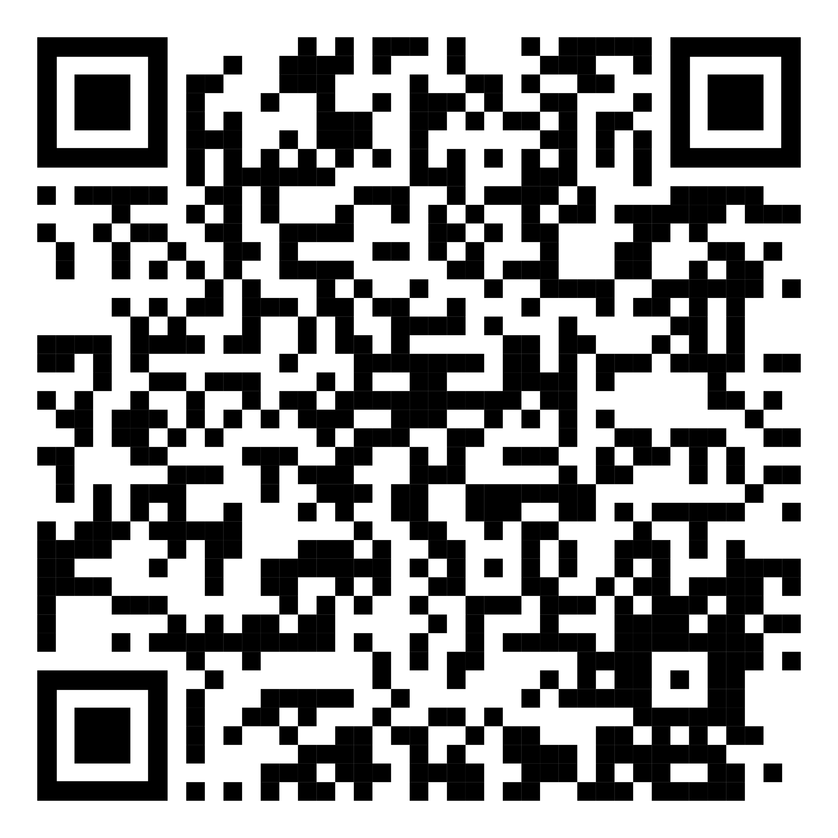
YOUR LOGO HERE
Stressed about quitting smoking?
Rid yourself of both with Pivot.
[Customized eligibility language].
Break the cycle of stress with the help of Pivot. Take back control and sign up today.
Scan the QR code with your phone and use access code [CODE]. Or visit pivot.co/partner.
Need help quitting vaping?
We’ve got a solution for that too!

