Slide 1


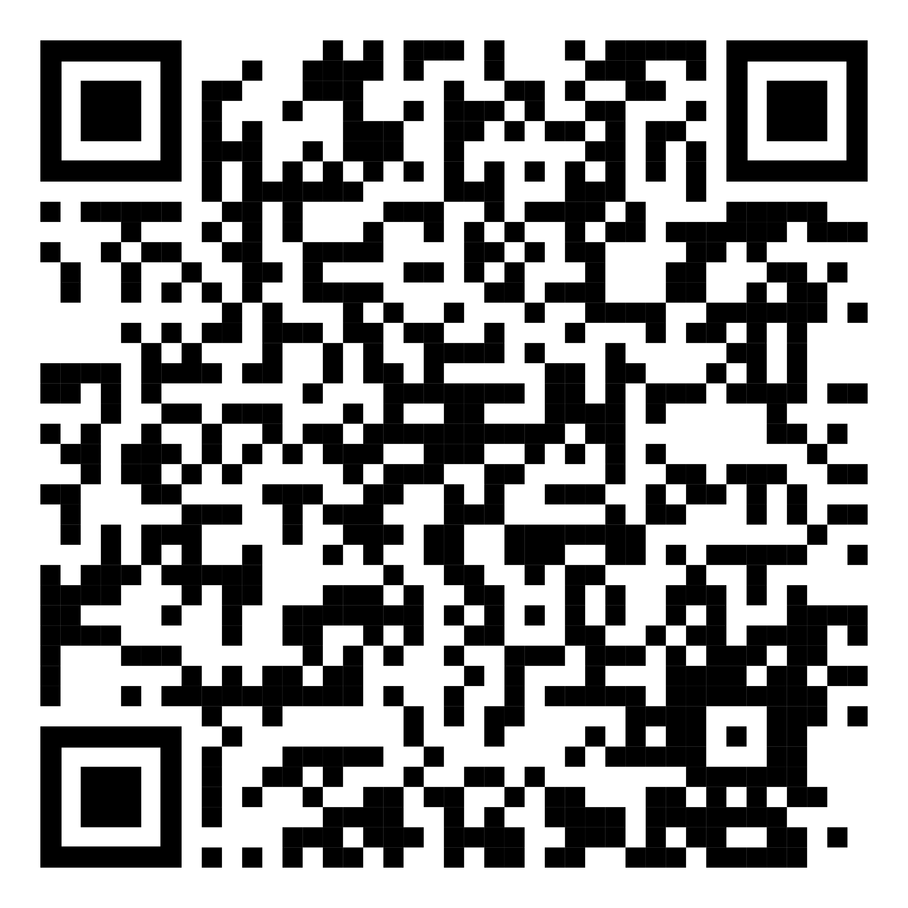
YOUR LOGO HERE
Stressed about quitting smoking?
Rid yourself of both with Pivot.
[Customized eligibility language].
Break the cycle of stress with the help of Pivot. Take back control and sign up today.
Need help quitting vaping?
We’ve got a solution for that too!
To learn more and sign up online, scan the code with your phone or visit pivot.co/partner and use access code: [CODE]

