Slide 1
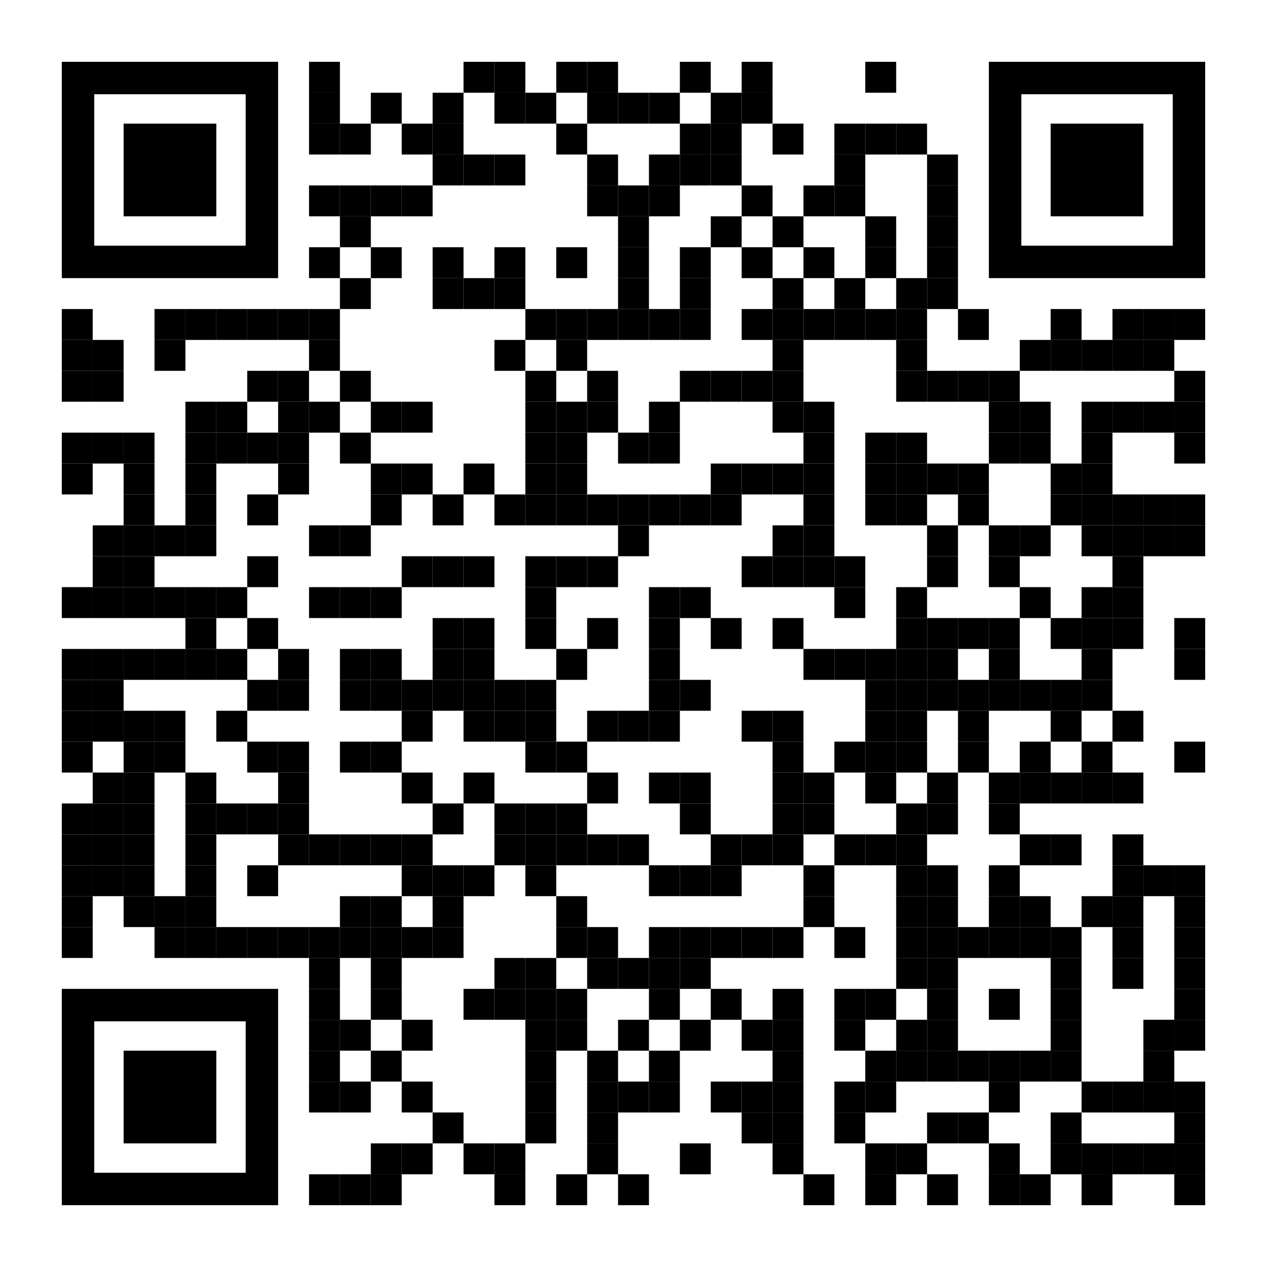
Say yes to summer fun with Pivot.
YOUR LOGO HERE
Get Started!
Don’t let tobacco get in the way of summer fun. Instead, kick the habit with the help of Pivot, the premier quit program!
Whether you’re ready to quit, wish it was the right time, or are exploring your options, Pivot can help you on your journey, allowing you relax and enjoy the summer months without the added pressure of failure or judgment.
Why light up when you can cool down?
Swap a cigarette for Pivot’s SmartSensor*, proven to help reduce the number of cigarettes smoked per person.
Pair the SmartSensor* with the personalized app, your dedicated coach, and nicotine replacement therapy (NRT)*. That means more time to enjoy summer, and no classes, phone calls, or obligations.
[Customized eligibility language].
Scan the code with your phone or visit [pivot.co/partner] and use code [CODE]
Need help quitting vaping? We have a solution for that too!
*Pivot is a flexible program designed to address all forms of tobacco use. The Pivot SmartSensor and NRT are only provided to those who smoke combustible cigarettes.

