Slide 1


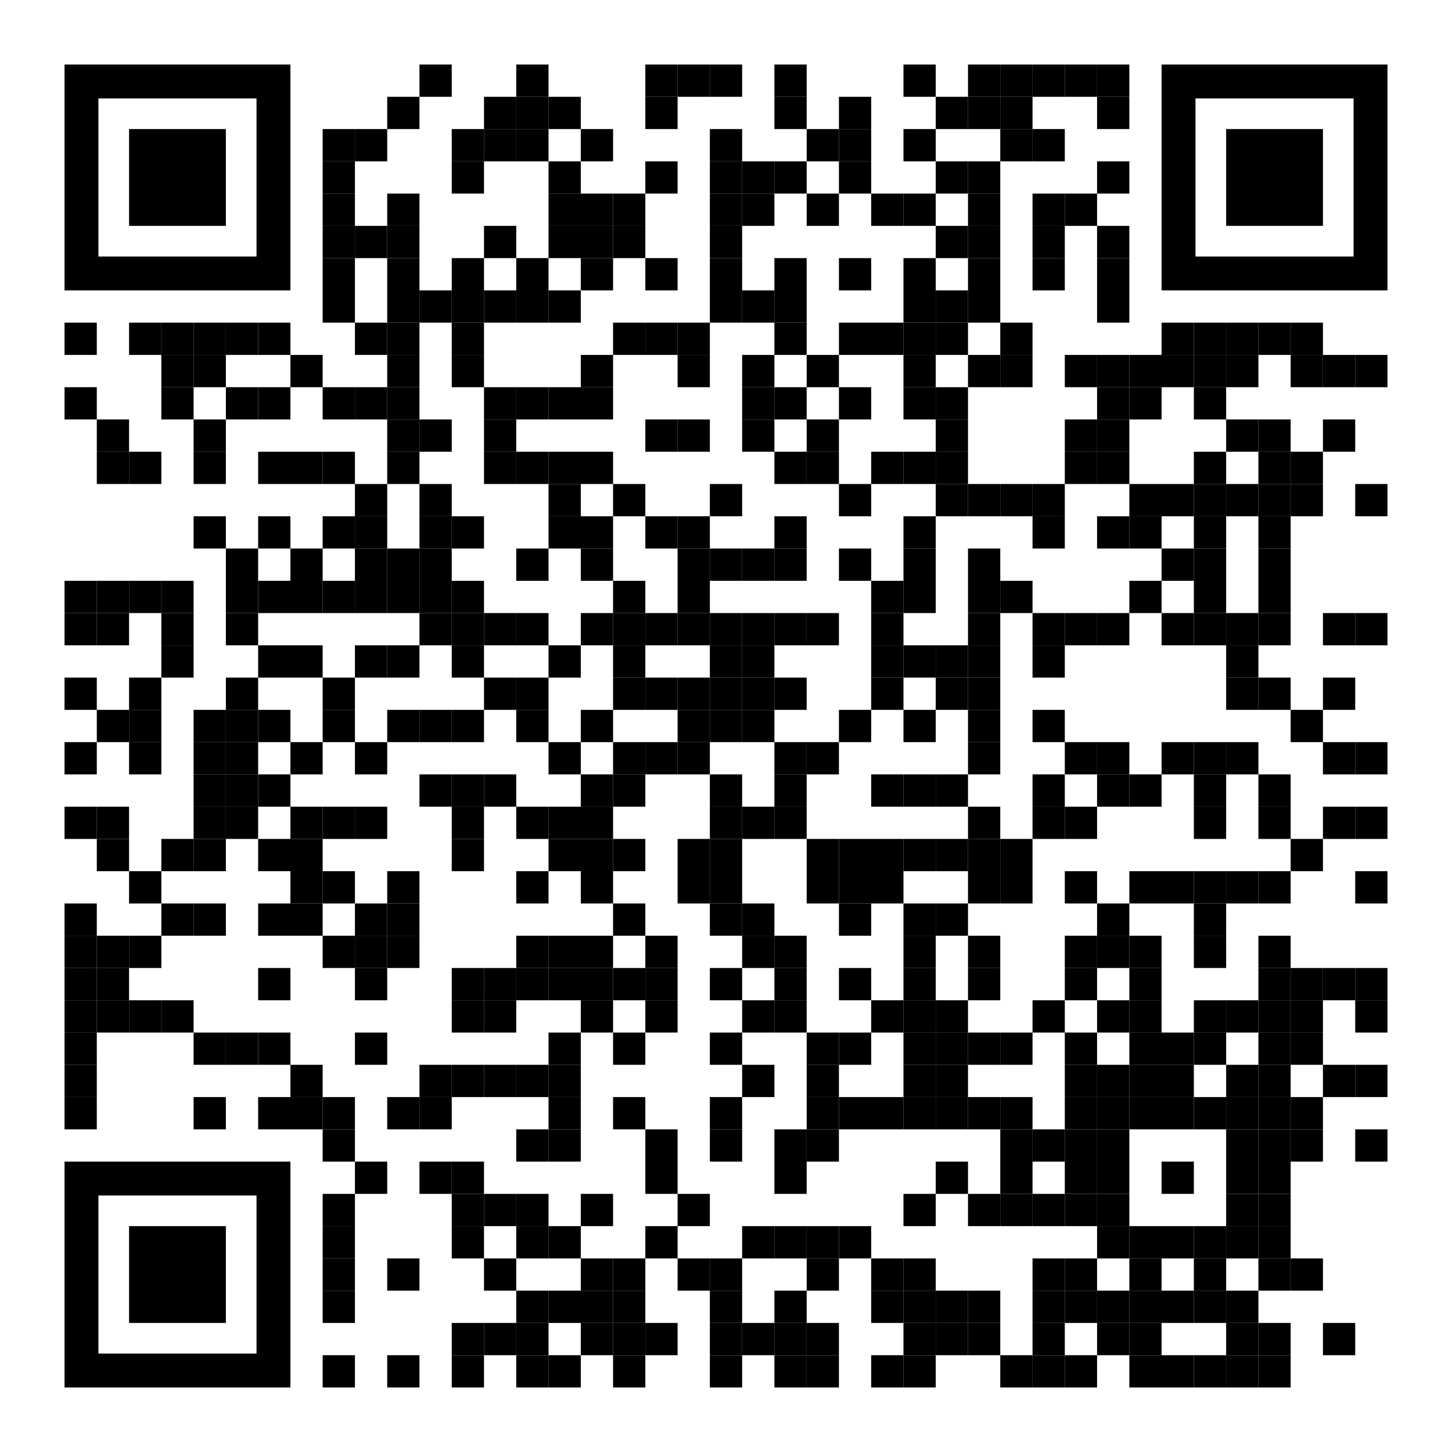
YOUR LOGO HERE
Breathe easier this summer with Pivot.
[Customized eligibility language].
Don't let tobacco get in the way of summer fun. Instead, give Pivot a try! Get started today and gain access to the first FDA-cleared SmartSensor*, proven to help in quitting tobacco.
Scan the QR code with your phone and use access code [CODE]. Or visit pivot.co/partner.
Need help quitting vaping? We’ve got a solution for that too!
*Pivot is a flexible program designed to address all forms of tobacco use. The Pivot SmartSensor is only provided to those who smoke combustible cigarettes.

