Slide 1


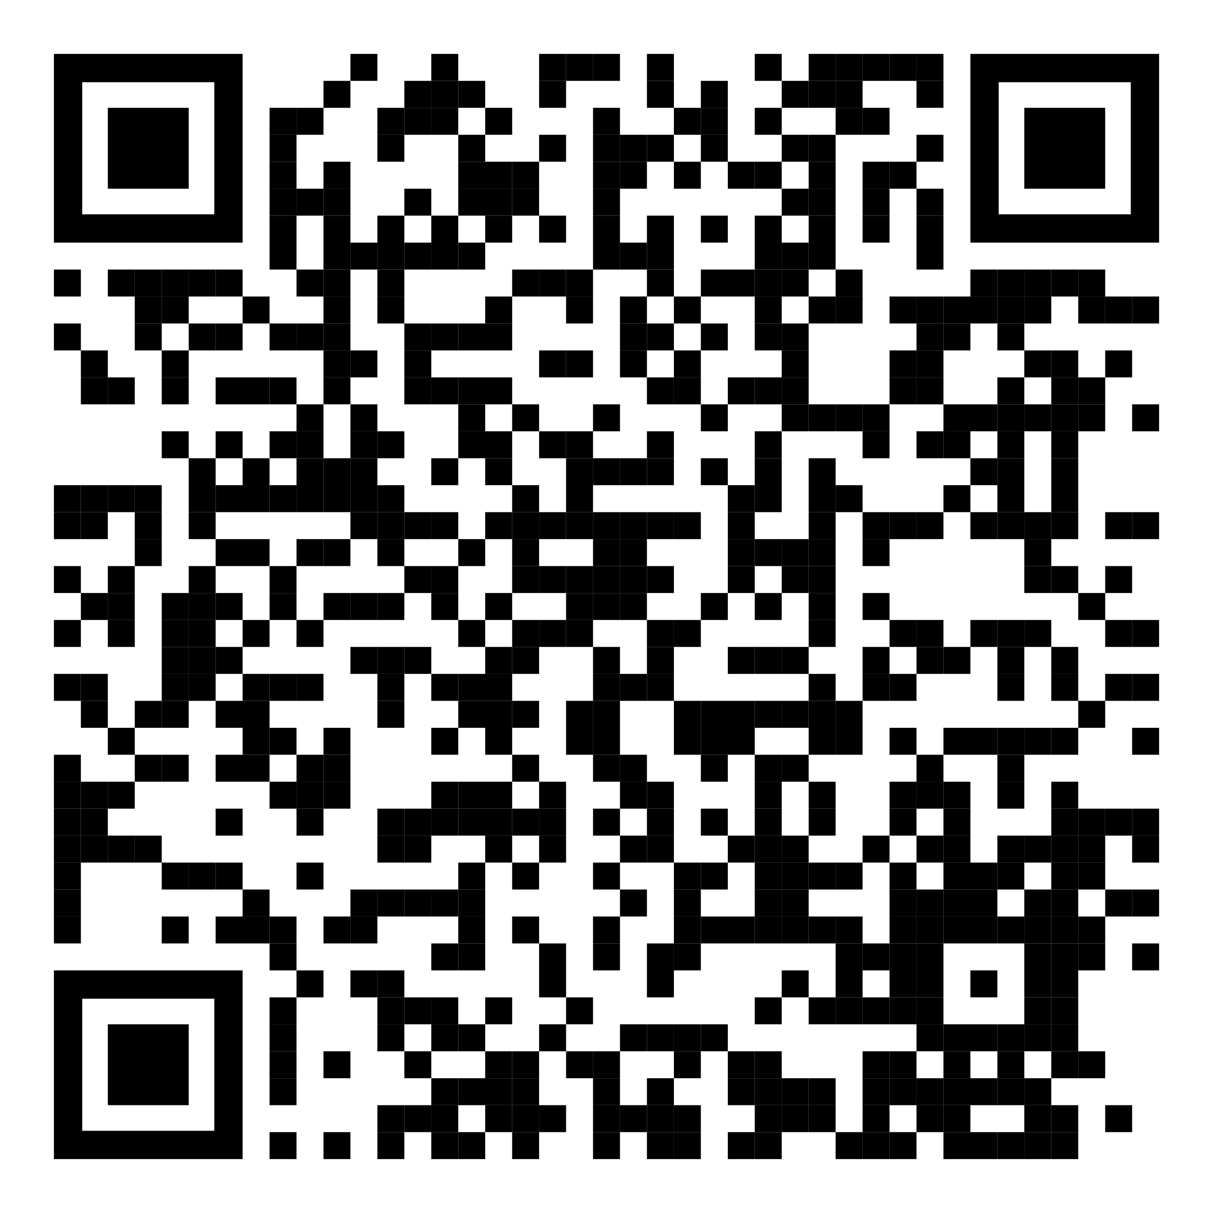
YOUR LOGO HERE
Breathe easier this summer with Pivot.
Take advantage of your chance to quit.
[Customized eligibility language].
Don't let tobacco get in the way of summer fun. Instead, give Pivot a try! Get started today and gain access to the first FDA-cleared SmartSensor*, proven to help in quitting tobacco.
Need help quitting vaping?
We’ve got a solution for that too!
*Pivot is a flexible program designed to address all forms of tobacco use. The Pivot SmartSensor is only provided to those who smoke combustible cigarettes.
To learn more and sign up online, scan the code with your phone or visit pivot.co/partner and use access code: [CODE]

